Slide 1

Charting the Course: Youth Employment Dynamics in the Evolving IT Landscape

Slide 2

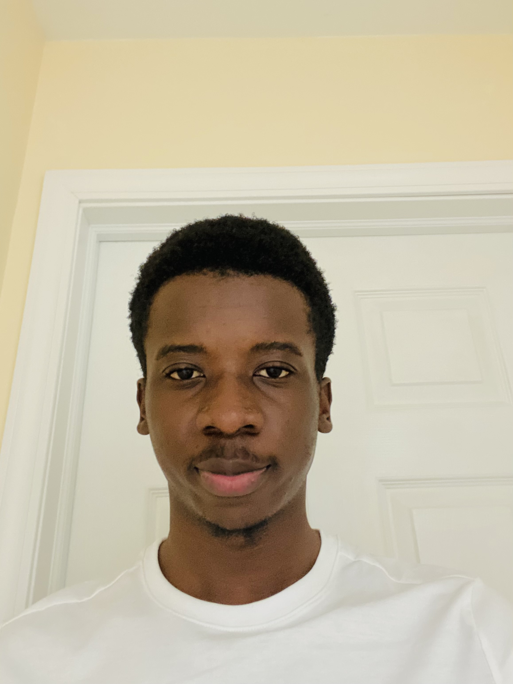

Introduction:
I'm Bradley Agwa, a passionate Data Scientist driven by an insatiable curiosity for data across diverse domains. .
My journey is fueled by a profound enthusiasm for problem-solving, which led me to immerse myself in the realm of data science—a space where I can meticulously design tailored solutions for each project.
Why I Decided To Participate:
I'm excited about the opportunity to explore job market trends and contribute to addressing youth employment challenges.
Participating in this hackathon aligns perfectly with my passion for leveraging data-driven solutions for societal impact.
Getting the chance to intern at World Data Lab will be ideal in my growth as a data scientist

Slide 3

Methodology
Methodology Overview:
In developing our project, I followed a systematic approach to analyze job market trends for youth in differen sectors and find out how this can provide insights in growing thr IT sector.
I used a combination of data analysis, visualization, and machine learning techniques.
Tools and Techniques:
I utilized Python as our primary programming language.
For data manipulation and analysis, we used pandas and NumPy.
I employed Plotly Express for creating interactive visualizations.
Machine learning models, such as Random Forest Regressor, were implemented using scikit-learn.

Slide 4
Another idea, equally important
Data Selection and Processing
Variable selection:
Data Preprocessing
Here I targeted key dimensions that would illuminate the youth job market landscape.
These dimensions include 'Country,' 'Sex,' 'Sector,' 'Year,' and 'Observed value.' By honing in on these variables, we aimed to capture a comprehensive view of employment dynamics within the different countries.
Country: This variable represents country associated with the data.
Sex: It categorizes the data based on gender.
Sector: Categorizes the different economical activities
Year: It indicates the time when the observation was made.
Observed Value: Holds the actual observed value or data points
I dropped columns I viewed surplus to requirements, only remaining with the variables I selected as highlighted
I formatted data in the columns (Sex and Sector), retaining only labels that were needed to facilitate analysis.
Data Transformation:
I filtered the dataset to encompass the years 2015 to 2024. This focused temporal scope allowed us to extract trends and patterns specific to this critical period of study.
I one- hot encoded Categorical variables(Country,' 'Sex,' 'Sector,'), facilitating seamless integration into our analysis pipeline.

Slide 5
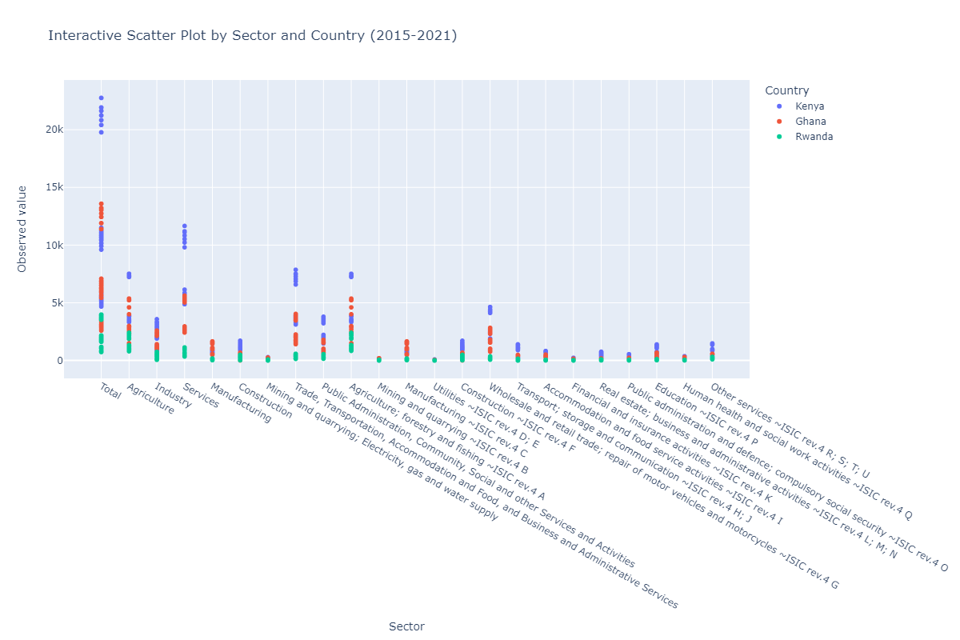
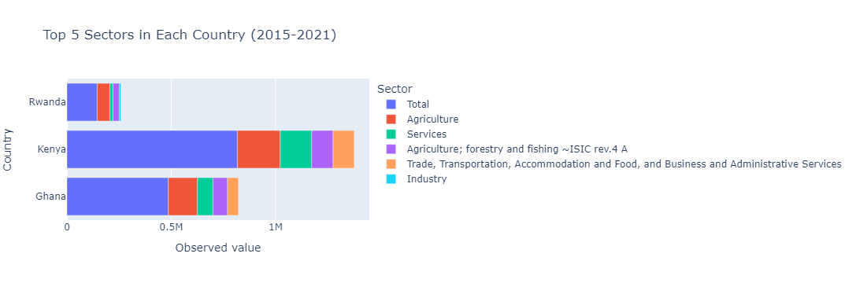
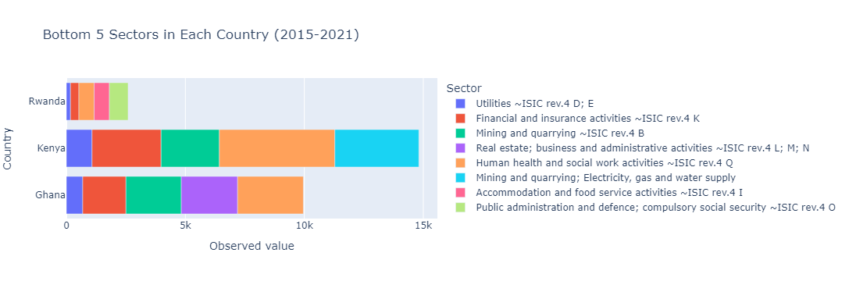
Another idea, equally important
Results
The above show some of the interactive data visualizations I made using Plotly in my notebook.
Aside from that I build a predictive model that can be used to predict future patterns. With the model scores being. 96% for XGB Regressor, 95.7% for the Random Forest Regressor and 94.3% for the Gradient Boosting Regressor.

Slide 6
Another idea, equally important
Findings/Insights
Illuminating Discoveries:
​
Agriculture and the service industries proved to be the sectors with the most youth employees, one can say it's due to the energy needed in those sectors .
Fluctuations in sector-specific observed values hinted at shifts in demand and supply dynamics within the different countries.
The exploration unearthed gender discrepancies in sector involvement, signifying areas for intervention.
Forging a Path Forward:
​
Blueprint for Transformative Policies: These findings are signposts for a strategic trajectory. They direct attention to the imminent need for policies that harness the rising youth interest and channel it into sustainable IT careers, shaping a robust foundation for future job markets.
Closing Gender and Skill Gaps: With gender disparities laid bare, our insights provide a compelling case for targeted strategies that empower and encourage underrepresented genders to thrive in the job market, moreso the IT sector.

Slide 7
Another idea, equally important
Recommendation/Gaps/Potential Impact
Strategic Blueprint for Action:
Synergy between Academia and Industry: A strong collaboration between educational institutions and industry players is paramount. This partnership not only fills skill gaps by aligning curricula with practical demands but also ensures that graduates are equipped with the competencies that elevate them as valuable assets in the workforce.
Sculpting Tomorrow's Workforce:
Unleashing Potential: By strategically utilizing our findings, stakeholders can reshape the trajectory of Kenya's youth and the IT sector. They can drive the transition towards a more inclusive, prosperous, and sustainable workforce—one where young talents thrive and innovation flourishes.
Empowering Tomorrow's Landscape:
Summarizing Contributions: In a nutshell, this project is a catalyt that equips decision-makers with actionable insights, positioning them to architect a future where the symbiosis between youth, technology, and growth is harmonious.

Slide 8
THANK YOU

Slide 9
